Slide 1

CSE 473: Pattern Recognition

Slide 2
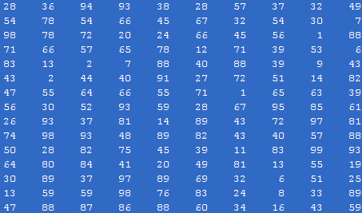

Correlation based TM
Goal: to find whether a specific known reference pattern resides within a given block of data.

Slide 3
Correlation based TM
Application: target detection, robot vision, video coding.
Frame at time t
Frame at time t-1

Slide 4
Correlation based TM
Application: target detection, robot vision, video coding.
Frame at time t
Frame at time t-1
Pixel value:
Pixel value:

Slide 5
Correlation based TM
Application: target detection, robot vision, video coding.
Frame at time t
Frame at time t-1
Pixel value:
Pixel value:
Difference:

Slide 6
Correlation based TM
Application: target detection, robot vision, video coding.
Frame at time t
Frame at time t-1
Pixel value:
Pixel value:
Difference:
We need to encode only the difference

Slide 7
Correlation based TM
There are two basic steps in such a procedure:
  Step 1: Move the reference pattern to all possible positions within the block of data. For each position, compute the “similarity” between the reference pattern and the respective part of the block of data.
  Step 2: Compute the best matching value.

Slide 8
Correlation based TM
There are two basic steps in such a procedure:
  Step 1: Move the reference pattern to all possible positions within the block of data. For each position, compute the “similarity” between the reference pattern and the respective part of the block of data.
  Step 2: Compute the best matching value.

Slide 9
Correlation based TM
There are two basic steps in such a procedure:
  Step 1: Move the reference pattern to all possible positions within the block of data. For each position, compute the “similarity” between the reference pattern and the respective part of the block of data.
  Step 2: Compute the best matching value.

Slide 10
Correlation In Image Matching
  Application to images: Given a reference image, r(i,j) of MxN size, and an IxJ image array t(i,j). Move r(i,j) to all possible positions (m,n) within t(i,j).
J
N
M
I
Reference, r
Test, t

Slide 11

Correlation In Image Matching
  Compute the distance:
    for every (m,n).
    For all (m,n), compute the minimum.

Slide 12
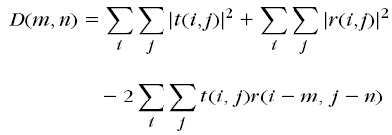
Correlation In Image Matching
The equation
can be written as

Slide 13
Correlation In Image Matching
In the equation
shaded terms are constant
provided pixel levels do not change much across the test image

Slide 14

Correlation In Image Matching
Canceling out the shaded terms, find point (m, n) that maximize:

Slide 15
Correlation In Image Matching
c (m, n) is no longer a difference term
This is called cross correlation

Slide 16

Correlation In Image Matching
In case gray level variation is valid, normalize:

Slide 17
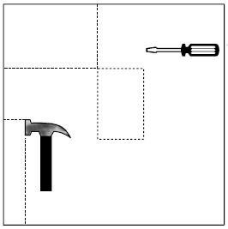

Correlation In Image Matching
Example:
Reference, r
Test Image, t

Slide 18
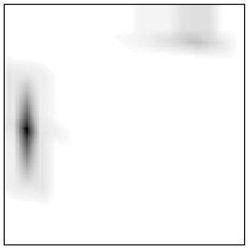
Correlation In Image Matching
Example:
Reference, r
Test Image, t
Correlation Image

Slide 19
Computation Considerations in Correlation Based TM (1)
Find c (m,n) at every pixel
This equation looks like convolution operation
Alternate is to calculate in the frequency domain

Slide 20
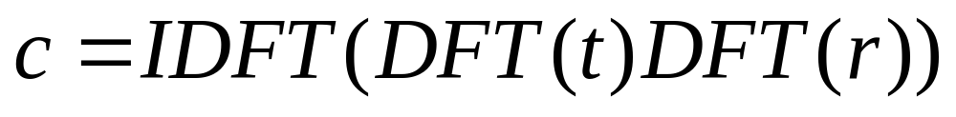
Computation Considerations in Correlation Based TM (1)
The frequency domain representation of
is

Slide 21
Computation Considerations in Correlation Based TM (2)
Limit the search space
  Search only in the area of [-p, p] X [-p, p] centered at (x, y)
r

Slide 22
Computation Considerations in Correlation Based TM (2)
Limit the search space
  Search only in the area of [-p, p] X [-p, p] centered at (x, y)
r

Slide 23
Computation Considerations in Correlation Based TM (2)
Limit the search space
  Search only in the area of [-p, p] X [-p, p] centered at (x, y)
r
(x, y)
(x + p, y + p)

Slide 24
Computation Considerations in Correlation Based TM (2)
Limit the search space
  Search only in the area of [-p, p] X [-p, p] centered at (x, y)
r
(x, y)
(x - p, y - p)

Slide 25
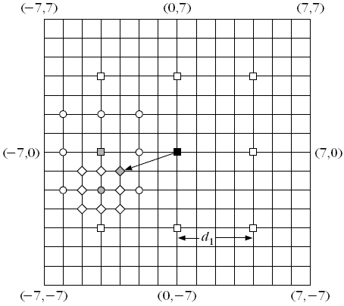
Computation Considerations in Correlation Based TM (3)
2D Logarithmic search
  Start with a rectangle of size [-p, p] X [-p, p]

Slide 26
Computation Considerations in Correlation Based TM (3)
2D Logarithmic search
  Search only at 9 points separated by d₁

Slide 27
Computation Considerations in Correlation Based TM (3)
2D Logarithmic search
  Maximum found at dark red

Slide 28
Computation Considerations in Correlation Based TM (3)
2D Logarithmic search
  Search in the rectangle of size [-p/4, p/4] X [-p/4, p/4] centered at dark red

Slide 29
Computation Considerations in Correlation Based TM (3)
2D Logarithmic search
  Maximum found at green

Slide 30
Computation Considerations in Correlation Based TM (3)
2D Logarithmic search
  Search in the rectangle of size [-p/8, p/8] X [-p/8, p/8] centered at green

Slide 31
Computation Considerations in Correlation Based TM (3)
2D Logarithmic search
  Maximum found at purple

Slide 32
Computation Considerations in Correlation Based TM (3)
Complexity MN(8k+1)

Slide 33
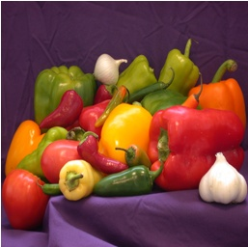

Computation Considerations in Correlation Based TM (4)
Hierarchical Search
  Search the reference in the area of size [-p, p] X [-p, p] centered at (x, y)
  Let, reference be of size 16X16
reference
test

Slide 34


Computation Considerations in Correlation Based TM (4)
Hierarchical Search
Level 0
Low pass Filter of Level 0
Original reference and test image

Slide 35


Computation Considerations in Correlation Based TM (4)
Hierarchical Search
Sub-sampled by 2
Level 0
Low pass Filter of Level 0
Level 1

Slide 36



Computation Considerations in Correlation Based TM (4)
Hierarchical Search
Level 1
Low pass Filter of Level 1
Sub-sampled by 2
Level 2

Slide 37
Computation Considerations in Correlation Based TM (4)
Hierarchical Search
. . . .
Level 0
Level 1
Level 2

Slide 38
Computation Considerations in Correlation Based TM (4)
Hierarchical Search

Slide 39
Computation Considerations in Correlation Based TM (4)
Hierarchical Search
2p
2p
(x, y)

Slide 40
Computation Considerations in Correlation Based TM (4)
Hierarchical Search
p/2
p
2p
(x/2, y/2)
(x/4 y/4
(x, y)
Level 0
Level 1
Level 2

Slide 41
Computation Considerations in Correlation Based TM (4)
Hierarchical Search
  Start at Level 2 with the reference of size 4X4
  Search in the rectangle [-p/4, p/4] [-p/4, p/4] centered at (x/4, y/4)

Slide 42
Computation Considerations in Correlation Based TM (4)
Hierarchical Search
  Start at Level 2 with the reference of size 4X4
  Search in the rectangle [-p/4, p/4] [-p/4, p/4] centered at (x/4, y/4)
  Let optimal found at (x₁, y₁) with respect to (x/4, y/4).

Slide 43
Computation Considerations in Correlation Based TM (4)
Hierarchical Search
  At Level 1, with the reference of size 8X8
  Search in the rectangle [-1, 1] X [-1, 1]
  centered at (x/2 +2x₁, y/2+2y₁)

Slide 44
Computation Considerations in Correlation Based TM (4)
Hierarchical Search
  At Level 1, with the reference of size 8X8
  Search in the rectangle [-1, 1] X [-1, 1]
  centered at (x/2 +2x₁, y/2+2y₁)
  Let optimal found at (x₂, y₂) with respect to (x/2, y/2).

Slide 45
Computation Considerations in Correlation Based TM (4)
Hierarchical Search
  At Level 0, with the reference of size 16X16
  Search in the rectangle [-1, 1] X [-1, 1]
  centered at (x +2x₂, y+2y₂)

Slide 46
Computation Considerations in Correlation Based TM (4)
Hierarchical Search
  At Level 0, with the reference of size 16X16
  Search in the rectangle [-1, 1] X [-1, 1]
  centered at (x +2x₂, y+2y₂)
  Location at this time is the final one

Slide 47
Computation Considerations in Correlation Based TM (4)
Complexity of Hierarchical Search
  9 × No. of Decompositions +
  Complexity at highest level

Slide 48
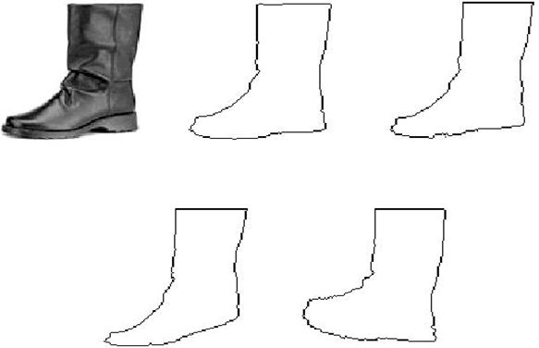
Deformable Template Matching
Why is Deformable Template Matching
  Test and reference patterns are seldom exact
  Rather, they are ‘similar’
  In CBIR, query sketch significantly differs from the shapes in image DB

Slide 49
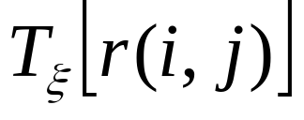
Deformable Template Matching
The philosophy: Given a reference pattern r(i,j) known as prototype:
  Deform the prototype to produce different variants. Deformation is described by the application of a parametric transform on r(i,j):
  Match the test pattern with each of the deformed patterns

Slide 50


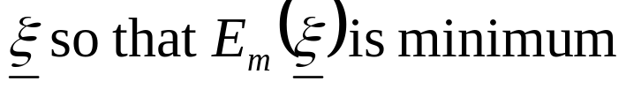
Deformable Template Matching
For different values of the parameter , the goodness of fit with the test pattern is given by the matching energy:
The goal is to chose

Slide 51

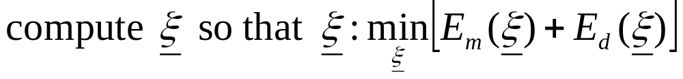
Deformable Template Matching
However, the higher the deformation, the higher the deviation from the prototype. This is quantified by a cost known as deformation energy:
In deformable template matching,
Thus target: small deformation and small matching energy

Slide 52
Deformable Template Matching
The essential elements
  A prototype of the reference
  Transformation function
  Matching Energy cost
  Deformation Energy cost

Slide 53
Deformable Template Matching
The prototype of the reference
  Should be representable
  Capture the mean shape characteristics of an object

Slide 54

Deformable Template Matching
Transformation function
  Any appropriate parametric operation
  A suitable transformation is:

Slide 55
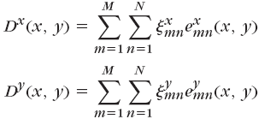


Deformable Template Matching
Transformation function
  Any appropriate parametric operation
  A suitable transformation is:
where,

Slide 56

Deformable Template Matching
Deformation Energy cost
  Alternately,

Slide 57

Deformable Template Matching
Matching Energy cost
  Captured as a function of point-to-point distance between reference and test pattern:

Slide 58


Deformable Template Matching
Matching Energy cost
  Captured as a function of point-to-point distance between reference and test pattern:
    is the displacement of the (i, j) pixel of the deformed template from the nearest pixel of the test template
    ρ is a constant
where,

Slide 59
Context Dependent Classification

Slide 60
Context Dependent Classification
Recall context free classification
  No relation exist among classes
  No relation exists among objects (feature vectors)
  A new object is classified to any class independent of the previous objects’ classes

Slide 61
Context Dependent Classification
In Context dependent classification, the class of a feature vector depends on
  Its own value
  Value of other feature vectors
  Classes assigned to other vectors

Slide 62
Context Dependent Classification
Application
  Communication
  Image Processing
  Signal Processing

Slide 63
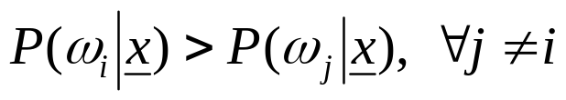
Solution for Context Dependent Classification
Recall Bayesian formulation for context free classification
  Assign x to ω_{i} if
In context dependent classification, we cannot apply it directly because of interdependency of features and classes

Slide 64
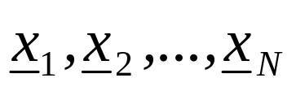
Solution for Context Dependent Classification
This interrelation demands the classification to be performed simultaneously for all available feature vectors
we assume that the training vectors
occur in sequence, one after the other and we will refer to them as observations

Slide 65
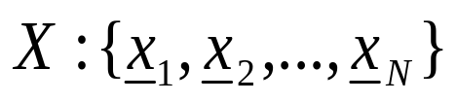



Context Dependent Bayesian Classifier
Let be sequence of observations
Let be the available M classes
Let be a possible sequence of assigned classes, that is
  where,
There are M^{N} of

Slide 66
Context Dependent Bayesian Classifier
Now, given and
Classify X to using the Bayesian rule
This is equivalent to classifying

Slide 67
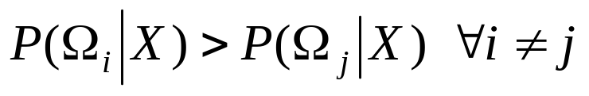

Context Dependent Bayesian Classifier
The rule
can be simplified as

Slide 68
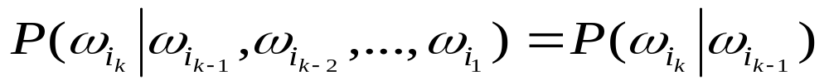
Further Simplification: Markov Chain Model
Markov Chain Models (for class dependence)
which means class dependence is limited to only within two successive classes

Slide 69
Further Simplification: Markov Chain Model
Markov Chain Models (for class dependence)
in other words,
if
then
depends on the class from which observation x_{k-1}, at stage k-1 has occurred

Slide 70

Further Simplification: Markov Chain Model
Markov Chain Models (for class dependence)
Therefore, we can write

Slide 71

Further Simplification: Markov Chain Model
Markov Chain Models (for class dependence)
Therefore, we can write
We find,

Slide 72

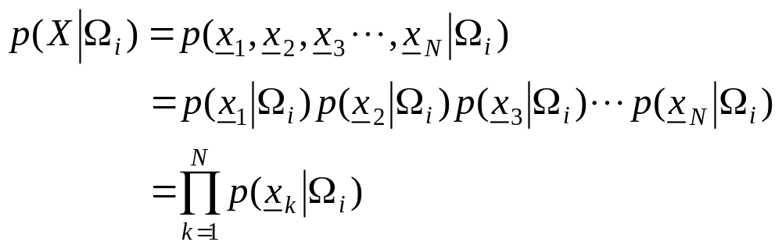
Further Simplification: Markov Chain Model
Further assumption
  statistically mutually independent

Slide 73
Further Simplification: Markov Chain Model
Further assumption
  statistically mutually independent
  If the pdf in one class is independent of the others, then

Slide 74
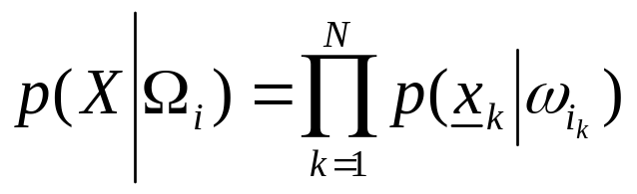
Further Simplification: Markov Chain Model
Further assumption
  statistically mutually independent
  The pdf in one class independent of the others, then
  Finally,

Slide 75
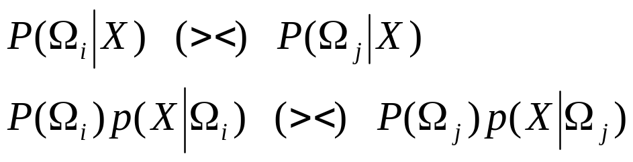
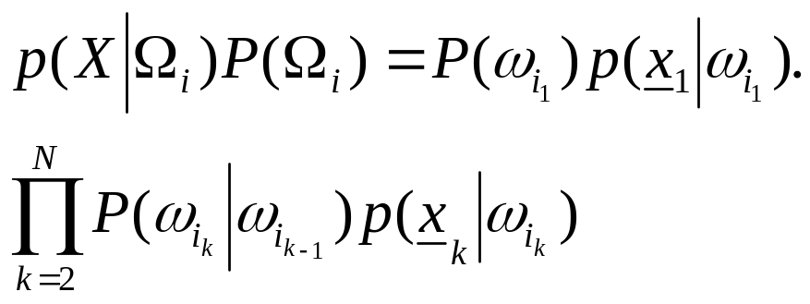
Further Simplification: Markov Chain Model
From the above, the Bayes rule is readily seen to be equivalent to:
that is, it rests on
To find the above maximum in brute-force task we need Ο(NM^{Ν} ) operations!!

